Slide 1



The Lost Puck
Stellaris
Rex Yu, Lubna, Chloe, Paul

Slide 2

introduction
Problem: students are always losing items on campus but there is no general space to post about found items or any items one is searching for.
To create a school wide lost &found program
The goal is to make it available as a website and an app
To provide RPI students an effective platform to post founded items and lost items
Easy access to make and track posts.

Slide 3
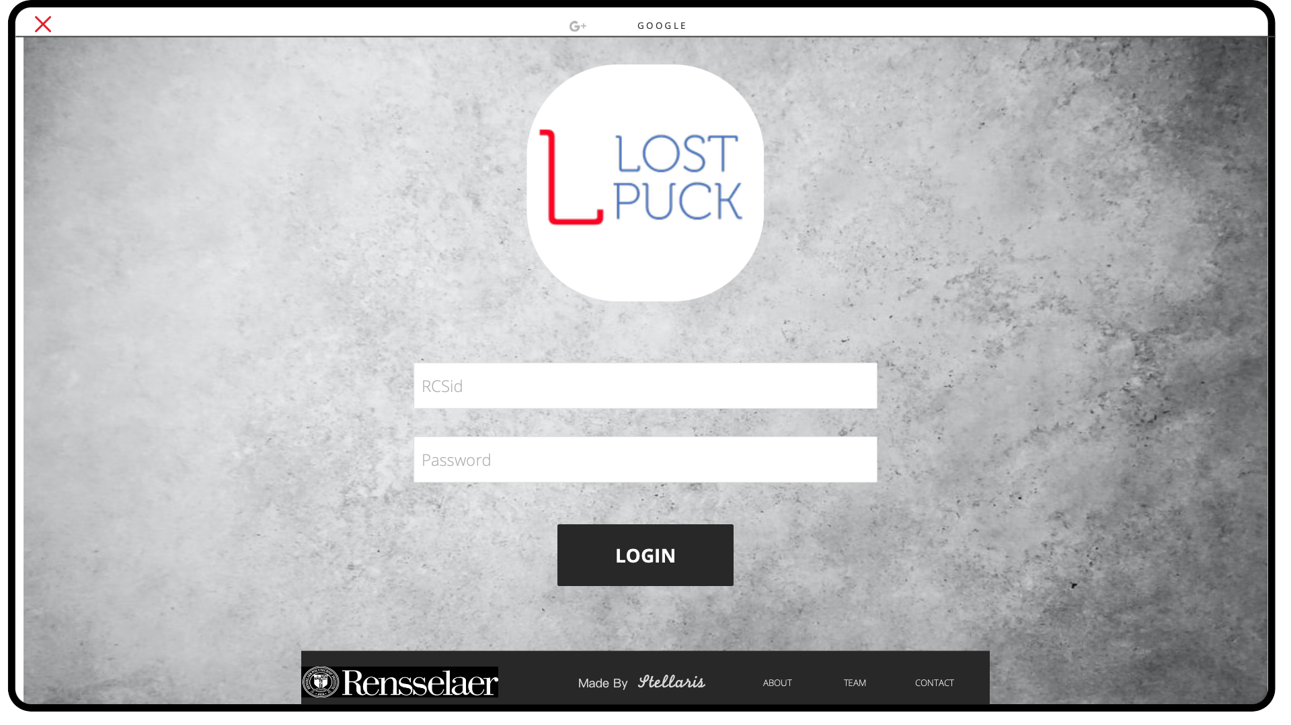
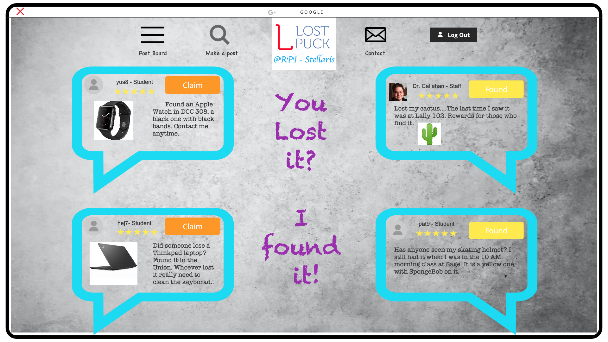
Wireframe

Slide 6
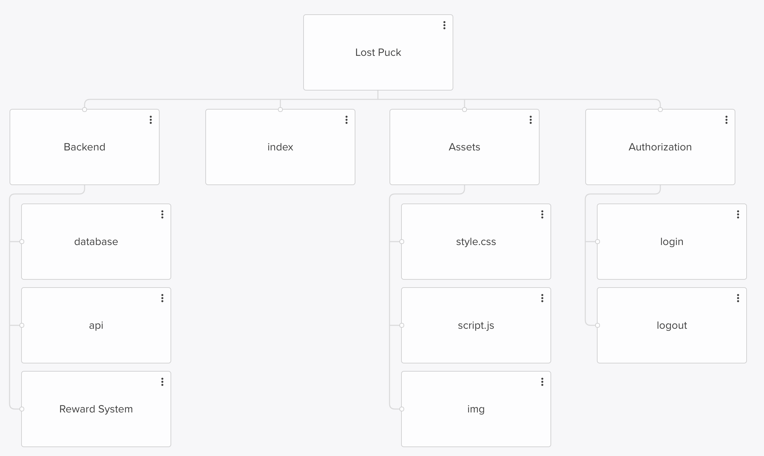
Site Map

Slide 7

Features
Users are going to login and out with their school identifications - RCSID
Message board – list of all posts – items found or lost
Claim button – to claim that the item posted is the one you are looking for
Found button – To let the owner know that you might have founded the item
Email contact – the owner and the founder can contact each other by RPI email

Slide 8

Functional requirements
If a user found their lost item posted on the message board, the user gets to click a 'Claim' button to be directed to the student's email who posted an item on the board.
If a user found an item and would like to post it on the board to find the owner of the item, the user should be able to upload a picture of an item and add a comment or description.
If a user would like to report a lost item on the board, the user should be able to upload a picture of an item and add a comment or description.
If a user found an item and saw the lost item report on the board, the user should click on a "found" button to be directed to the student's email who reported a lost item on the board.

Slide 9

NON-Functional Requirements
Security
RCSid as identification proof
Banners and alert before submitting any post to educate users how to safely meet up in a common area to retrieve their lost item.
user's privacy will be protected as the system will re-route the users to the other's email when matched in cases of claim/found
Reliability - will be achieved as we take feedback upon user experience and reflect on them to improve the system.
Performance - Lost Puck should be well built on a server to be accessible from every user's laptop regardless of their location
Scalability & Maintainability – The ability to be increased in size and stably maintained in the future
Usability - RCSID authentication to ensure that people outside of the RPI community shouldn't be involved in the Lost-Found activity

Slide 10

Interesting techonologies
A reward system
For users who have founded an item and gotten it back to the correct owner.
Points system – users can accumulate points through continuous helpfulness and these point rating will appear with his post

Slide 11

competitors
Few
A campus lost & found in the Folsom Library but not quite useful as it costs time and a walk to put the founded item in there or search the box.
WebEx Teams Spaces
Effective for message sending
Most of the chats tend to get drowned out since they are not an event reminder or specific

Slide 12

stakeholders
Any students and staff member at RPI
No cost to post or access the application

Slide 13




STRENGTHS
WEAKNESSES
Unique
Meaningful and helpful
Relatively not difficult implementation
User base required (Attention)
Up-to-date maintenance required
S
W
O
T
OPPORTUNITIES
THREATS
Pioneer of self-made student service application
Competitors
User trust – possible fake and spam information

Slide 14

Q&A

